Slide 1
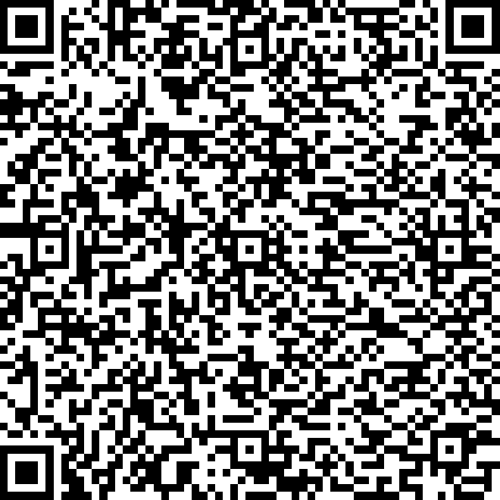

An Introduction to R
Workshop 1
Please record your attendance:
Laura Dean
LIFE4138
laura.dean@nottingham.ac.uk

Slide 2
Learning objectives and outcomes
By the end of this session you should be able to:
Understand what R is and how to interact with it
Use R Studio as an interface and project management system
Understand data types, structures and functions in R
Read in and manipulate data in R
Use R to draw simple plots
Install and load packages in R

Slide 3
What is R?
Freely available programming language
Developed in early 1990s, established as open source in 1995
An environment for statistical computation and visualization
Interactive, interpreted language
Efficient data handling and storage
Collection of tools for data analysis
Dedicated visualization and graphics tools
Simple programming language
Notes:
R's ethos was to develop something specifically for statistical computation and visualisataion - it was developed **by** researchers, **for** researchers.

Slide 4




Why use R?
R is a major component of the bioinformatic toolkit
It is explicitly designed for handling data in data frames
Free, widely used and well-supported
Of 60,000 ecology & evolution papers R used by 60% (Lai et al 2019)
Increasingly used in data science for major tech companies
Notes:
* The "default" language varies from field to field, but certainly in ecology and evolution, you're likely to be working with colleagues who use R (interestingly, ecologists were actually one of the first user bases of R)
* R is designed to be an efficient, interpreted language in a way that is fundementally different to the initial design of Python, which is typically interacted with via a script. R is designed to be a sort of "statistical conversation" where you interactively program.
* R was designed to have efficient data handling and storage mechanisms. There aer lots of types of data structures in R - these might seem unnecessary at first, but as we delve deeper into R and how it works, you'll see why they're important. R is written in a way that makes accessing reasonably sized datasets super efficient. Typically, this is not true of Python for a plethora of reasons that we don't have the time to talk about (although admittedly this is getting better with the advent of modules such as Pandas)
* R contains a large collection of tools specifically developed for data analysis, as well as some really good built in data visualisation features!
* There is a huge multiverse that has been built around R with loads of different flavours associated with it. We'll discuss this in more detail next week.
* Finally, R is fundementally designed to be simple. This is why it's taught to non-programmers. You don't have to do complicated things like for loops if you don't want to (although we're going to!). These can be avoided and R can be used for it's base functionality of data analysis and plotting with no fancy extras if you don't want them.
More specifically:
* R is a major part of the bioinformatic and biostatistics toolkits, and it isn't going away any time soon.
* It was explicitly designed to handle data, particularly in a format known as data.frames - this is extremely important to the way that R functions
* It is free, and widely supported. In Evolution and Ecology papers in the last decade, 66% mention R. If you want to have a career in research, R is a vital skill.
* R is used by loads of major tech companies for their analytics - including facebook, google, and twitter!

Slide 5
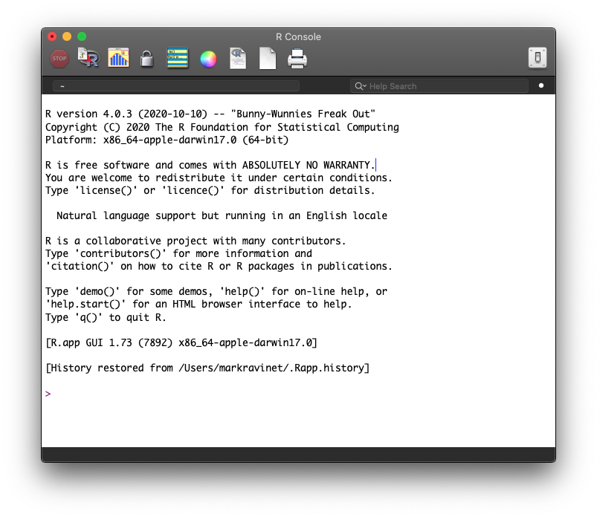
Interacting with the R environment
Access base R directly – i.e. via Windows/Mac OS X GUI
https://cran.r-project.org/

Slide 6

What is R Studio & why use it?
IDE (integrated development environment)
Open source (but paid options available)
Standardizes R interface across platforms
Lots of powerful features that makes using R straightforward
Excellent project management tools
www.rstudio.com
Notes:
Here, we will use an R IDE, known as RStudio (although you might also hear it referred to as posit). An IDE, is a built-on interface that helps you to run a programming language more easily and effectively. Other examples of IDEs can be found in Python - you might have come across Spyder or Jupyter for example. RStudio is completely free, and the best R IDE I've found. It's also the most well supported, which is useful. There are others, but RStudio is particularly good. It will help to make your R journey much smoother, and actually helps you to spot errors in your code, which is always a bonus!

Slide 7
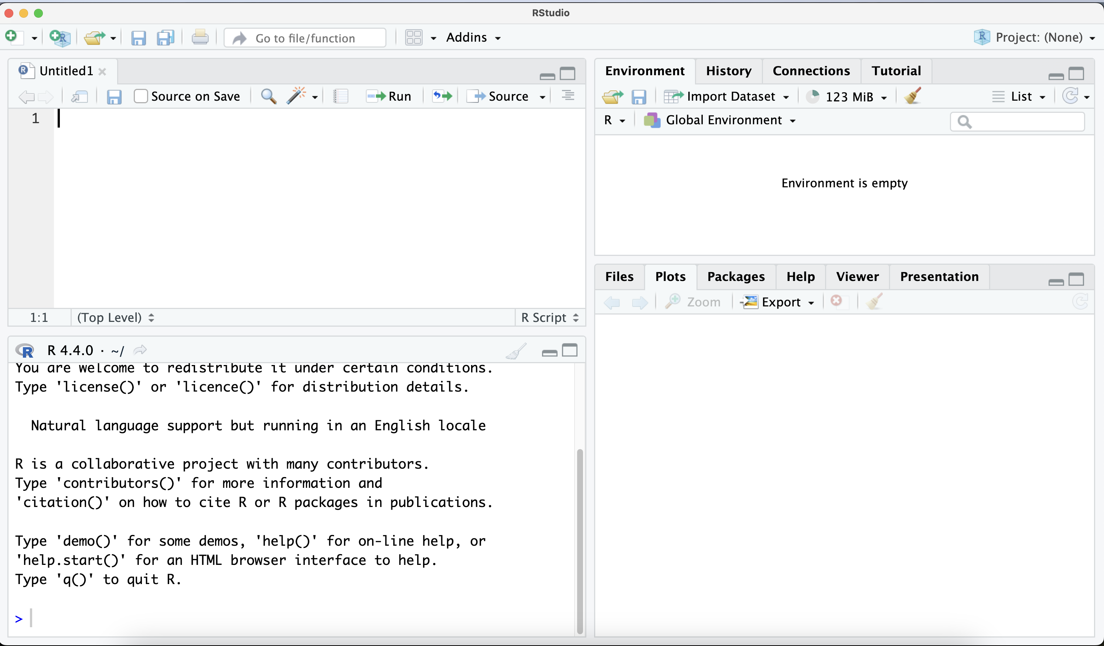
The R Studio interface
Scripts
Environment
Files/Plots/Help
Console

Slide 8
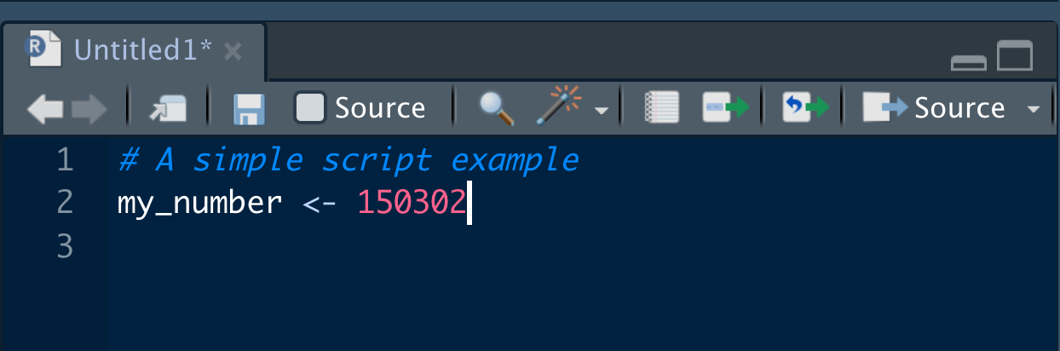
A note on scripts
Scripts act as a record of what we have done
Think of it as a live document you can edit and add to
Comment, comment, comment!
Lines with # are comments
These are NOT interpreted
To create a script: File > New File > R Script

Slide 9
The R language
R is an object-oriented language: an object in R is anything (constants, data structures, functions, graphs) that can be assigned to a variable
Data types in R
Data type | Example
numeric | 40.5
integer | 100
character | “Hedgehog”
factor | “Hedgehog”
logical | TRUE
Notes:
Use character if your data is just strings that do not hold specific meaning; use factor if it's a categorical variable with a limited set of values

Slide 10
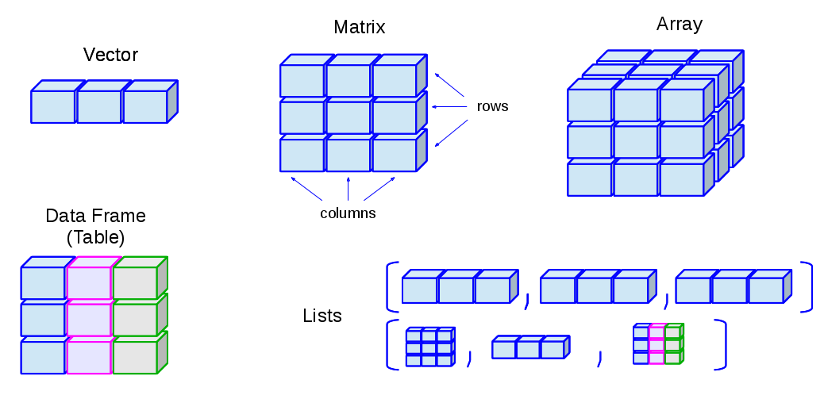
Data structures in R
Data types:
numeric, character, logical
Notes:
Different colours in this figure represent different data types.

Slide 11
Vectors
“A series of values”
Can be numeric OR character OR logical
Most common and most basic data type in R
An important building block for other data structures
Examples…
12 3 5.4 9 100 23.7
“Hedgehog” “Squirrel” “Pigeon”
TRUE TRUE FALSE TRUE FALSE

Slide 12
Matrices
A data structure that stores data in rows and columns
Can be numeric, character or logical but not a combination
Example…
1 | 66 | 8 | 4 | 6.2 | 6
78 | 3.9 | 5 | 1 | 4 | 99
9 | 23 | 45 | 6 | 6.8 | 9
4 | 4.4 | 9 | 0.5 | 0 | 1
6.6 | 8 | 7 | 5 | 61 | 1
9 | 23 | 5 | 5.7 | 6 | 2
Notes:
Matrices can be either numeric, character strings or logical values but they can only be one data type, you can’t mix data types.
And realistically matrices will usually be numeric

Slide 13
Data frames
Similar to a matrix – 2D with columns & rows
Can store different data types: numeric, character, logical
Must have named columns.
Example…
Species | Height | Furry | Colour | Lifespan
Hedgehog | 3.9 | TRUE | Brown | 2
Squirrel | 4.0 | TRUE | Grey | 4
Pigeon | 3.5 | FALSE | Grey | 6
Fox | 8 | TRUE | Red | 5
Badger | 6.7 | TRUE | Grey | 5

Slide 14

Practical time…
Open R studio and we will work through some examples together
Please record your attendance:

Slide 15
Try it yourself tasks:
Create a vector, with 10 numbers, print your vector to the console
Print the length of your vector to the console
Replace the 4th number in your vector with 100
Create another numeric vector and combine your 2 vectors into a matrix, print your matrix to the console
Print the dimensions of your matrix to the console
Create a data frame with 4 variables, make your variables a mixture of character, numeric and logical classes.
Print your 2nd variable to the screen using 2 different methods
BONUS: Replace the first variable in your data frame with a new one

Slide 16
Try it yourself tasks:
Create a vector object containing 10 numbers.
Create a second vector object that is your first multiplied by 20.
Create a matrix object from the vectors you made in 1 and 2.
Print the dimensions of your matrix then print the information in the 2nd row of the 1st column.
Create a data frame object with 3 variables, one character, one numeric and one logical
Extract a single column from your data frame and assign it to a new vector object

Slide 17
An introduction to functions
Functions are the bread and butter of R
They are code that takes one or more arguments as input, performs a process and returns a result
Thousands of functions in different packages
You can (and will) write your own!
Often come with built-in help
Examples…
seq(from=1, to=10, by=2)
c(1,8,3,6,90,3,2,2,0,8,4)

Slide 18
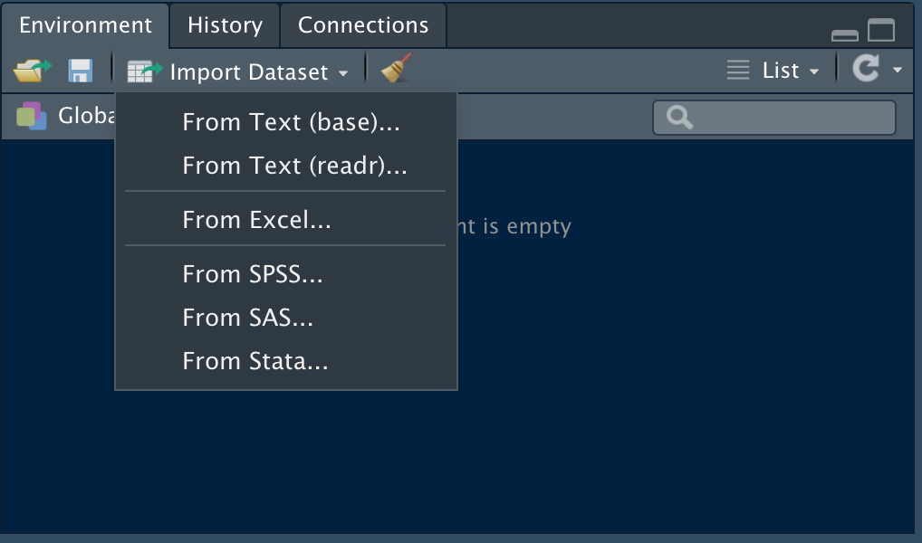
Reading in data – the easy way
Most often you will need to read external data into R
You can use Rstudio to do this:
A good way to learn at first (as it will print code to console) but not as flexible as learning functions to read data

Slide 19
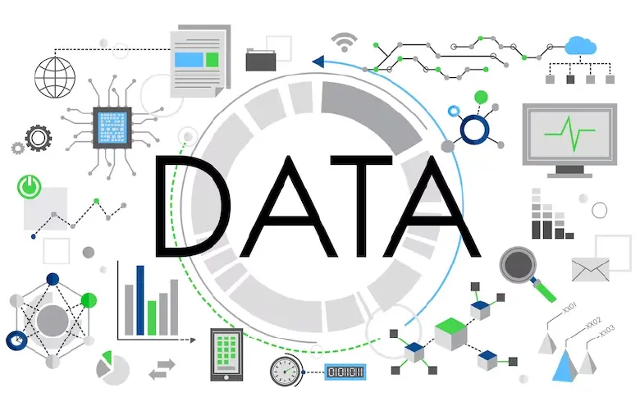
Reading in data – the better way
Many different functions and ways exist
For csv files a great function is read.csv()
For most tables csv or not read.table() is great, but usually needs some additional arguments to get it completely right
R will automatically look in your project directory for files

Slide 20
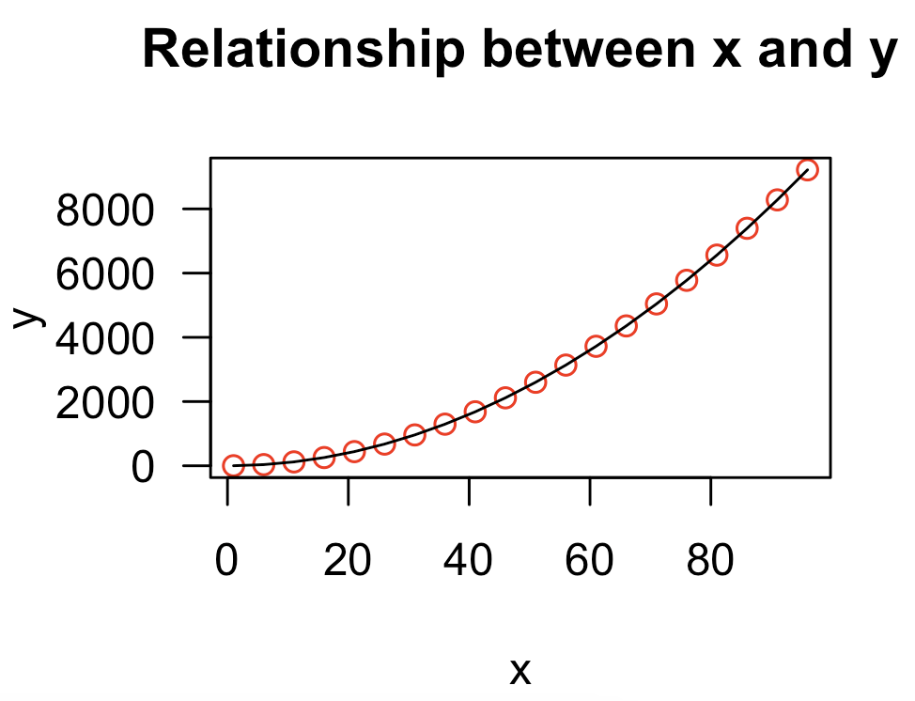
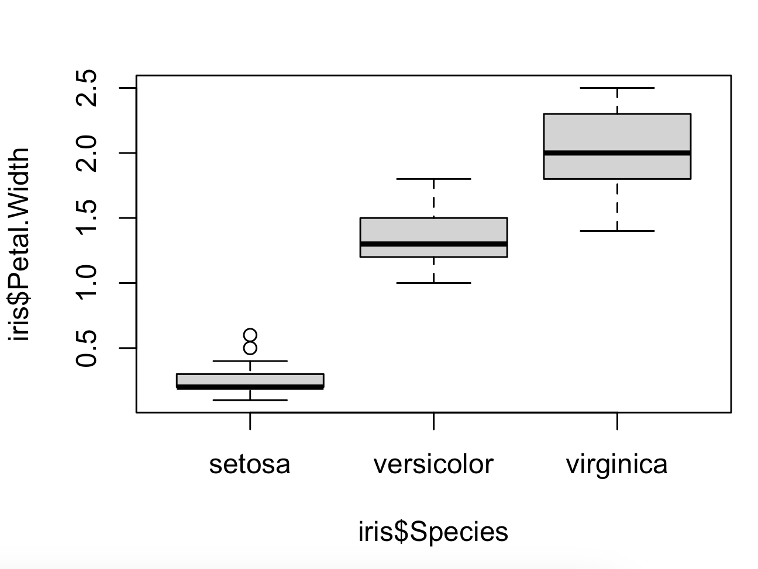
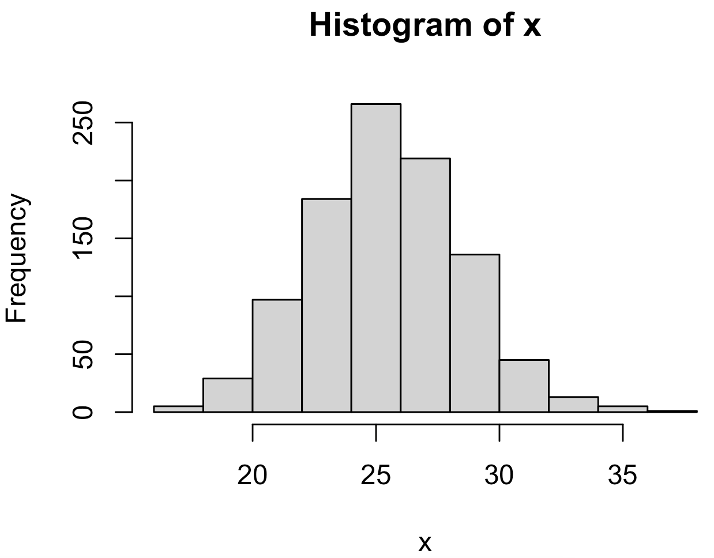
Plotting data
ggplot2 package is gold standard but we’ll start with baseR
Many simple plots with plot(), boxplot() and hist() functions

Slide 21
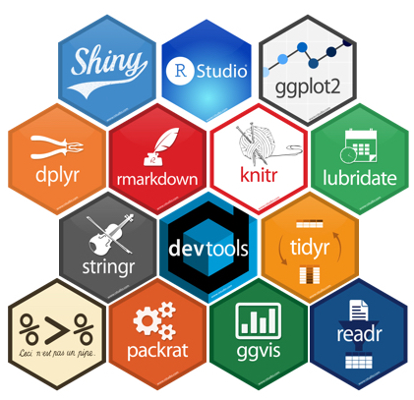
R packages
Packages contain additional functions, data and documentation
Can be installed from the Comprehensive R Network (CRAN)
Over 18,357 currently listed
Other repositories include Github and BioConductor
Packages only need installing once, but must be loaded into your environment every time you restart your R sessison
Notes:
Packages in R are the same as modules in Python

Slide 22
Practical time…
Open R studio and we will work through some examples together
Notes:
Packages in R are the same as modules in Python

Slide 23
Try it yourself tasks:
Clear your environment
Create a data frame with 3 variables, one character, one numeric and one logical
Save the data frame to your project directory then remove in from your R environment
Read the data frame that you saved back into R using the read.csv() function
BONUS: Remove the dataframe you created from your R environment again and read it back in using read.table(), see if you can troubleshoot the options to get the data read in correctly.
Create 2 numeric vectors and make a scatter plot of them, give your plot a title
Load the iris data and make some boxplots of the different variables
BONUS: Add axis labels and a title to one of your boxplots

Slide 24
Learning objectives and outcomes
By the end of this session you should be able to:
Understand what R is and how to interact with it
Use R Studio as an interface and project management system
Understand data types, structures and functions in R
Read in and manipulate data in R
Use R to draw simple plots
Install and load packages in R

Slide 25

Some further tips for learning R
Experiment – not much can go horribly wrong!
Practice, practice, practice
There is no one single right way
Use resources online – Google, Stackoverflow, R forums
Take a break – a walk and a cup of tea do wonders

Slide 26
Next Time…
TidyR packages
Data manipulation
Advanced plotting with ggplot2

Slide 27

Homework!
Homework for this workshop is provided as a jupyter notebook on Moodle
Please complete the homework for next session
Please record your attendance:

